Slide 1

Ashwin (alakshm6)
Gaurav (garadhy)
Stuti (snanda)

Slide 2
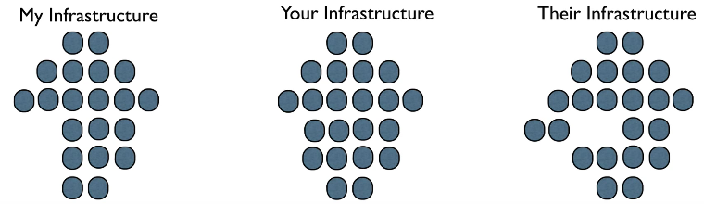
Managing multiple infrastructures can be daunting ...
Infrastructure can expand quickly
With growing components, complexity increases

Slide 3

You don’t want to end up wondering ...
How did I do that?
Who changed that?
Why did I do it that way?
And when a component dies ...
I have to rebuild this again, figuring out ways in which infrastructure components fit together.

Slide 4
Chef to the rescue ...
Automation framework for automating infrastructure and applications
Configuration management tool
Infrastructure as code
Written in Ruby, Erlang
Infrastructure aware
Idempotent

Slide 5
“ Documentation : Code :: Chef : Infrastructure ”

Slide 6
Chef Terms ...
Knife
Recipe
Cookbook
Runlist
Marketplace

Slide 7
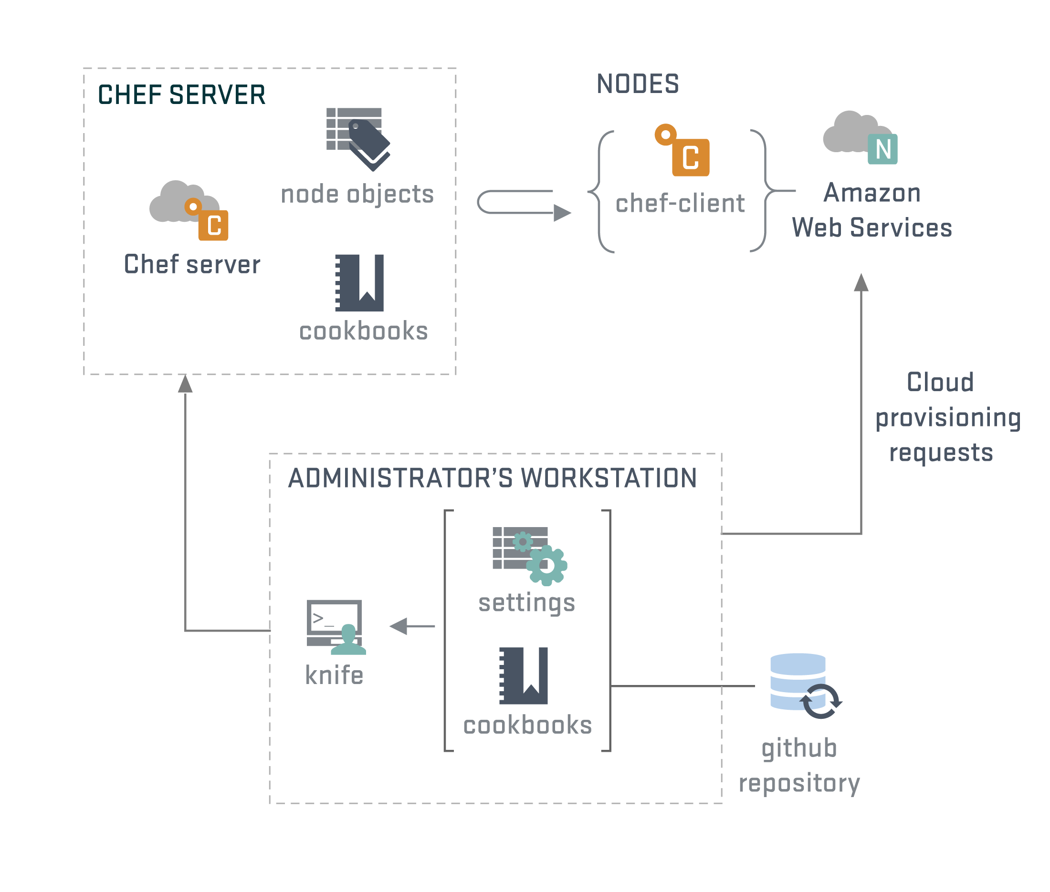

Slide 8
With Chef, you can manage ...
Packages
Services
Users, Groups
Networking
Files, Directories
And many more things ...

Slide 9
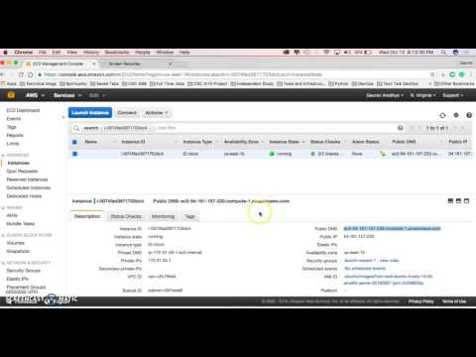

Slide 10
Chef vs Ansible
Learning Curve
Adoption constraints (developers vs admins)
Ease of use
Maturity
Community
Pull vs Push Model

Slide 11
Verdict
Modular
Community support
Mature product
Marketplace
Overall, chef seems a good option, albeit the steeper learning curve!

Slide 12

Thank you!

Slide 13
Resources:
https://www.chef.io/
http://www.slideshare.net/AmazonWebServices/chef-cookbook-workflow
https://www.upguard.com/articles/puppet-vs.-chef-revisited
http://www.slideshare.net/adamhjk/infrastructure-automation-with-chef
http://www.slideshare.net/JulianDunn/chef-introduction-princeton-meetup
http://www.slideshare.net/vhata/devops-and-chef/42-SERVER_chefclient_on_node_use
http://www.slideshare.net/jweiss/infrastructure-automation-withchef

Slide 14

Questions ?

